Slide 1



Unsupervised Learning Project by Abi Afolabi 28th Aug 2023

Slide 2
Project Overview & Goals
Reinforce learning with hands-on experience
Apply unsupervised learning techniques to a real-world data set and use data visualization tools to communicate the insights gained from the analysis.

Slide 3
Project Execution Steps
Import Libraries & Dataset
Exploratory Data Analysis (EDA)
Feature reduction with PCA
Use K-Means & Hierarchical techniques to create Clusters
Perform Data Preprocessing
Notes:
POIs are Restaurant & Employment Services

Slide 4
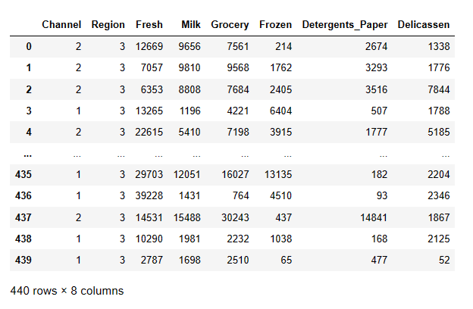
Dataset in Pandas DataFrame showing table columns and dimensions

Slide 5
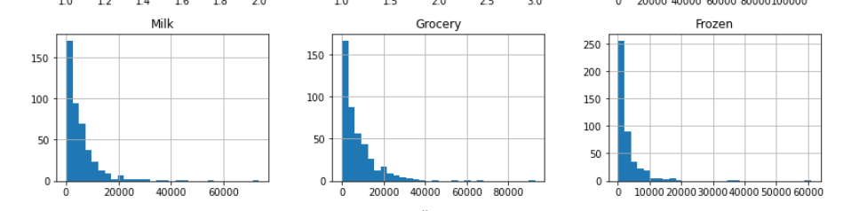
Discoveries from EDA – Histogram
Dataset is mostly asymmetrical and right skewed

Slide 6
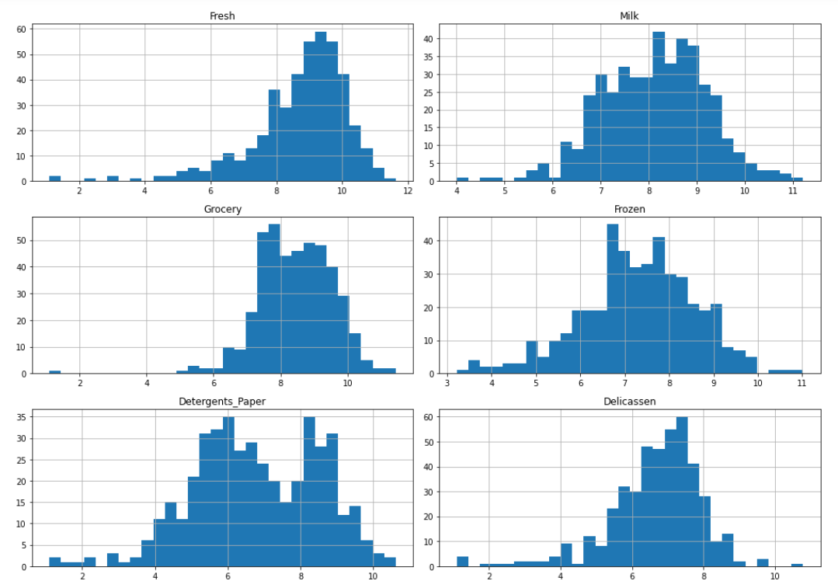
Histogram Plot After Log Transform

Slide 7
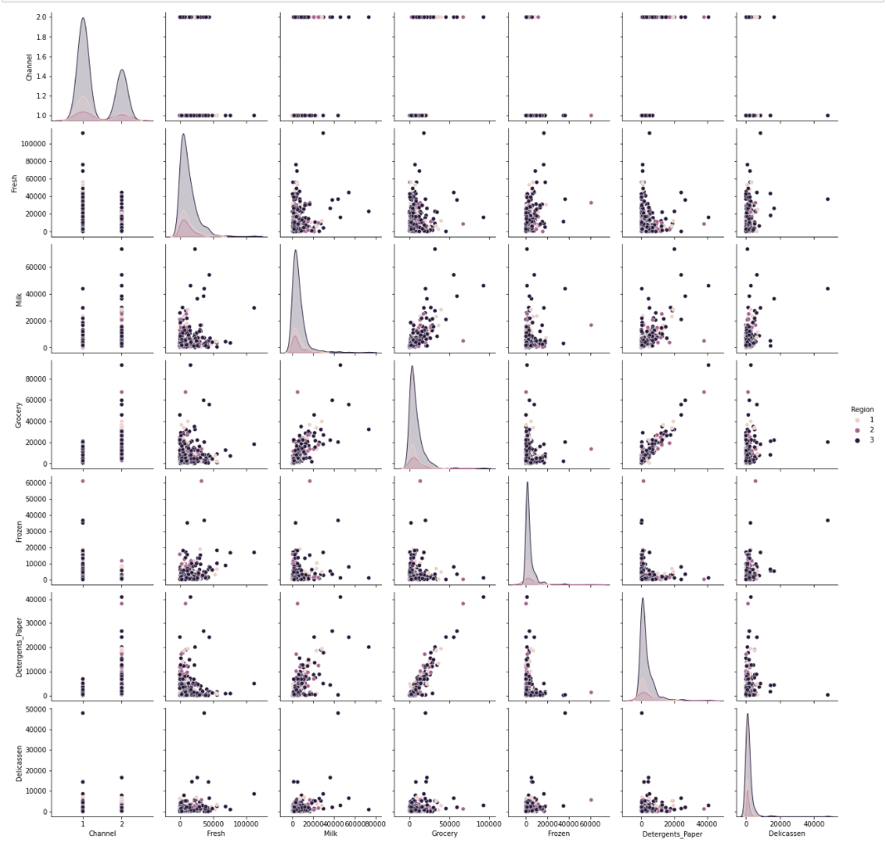
Discoveries from EDA – Pair plot
Pair plot shows most purchases occurred in region 3

Slide 8
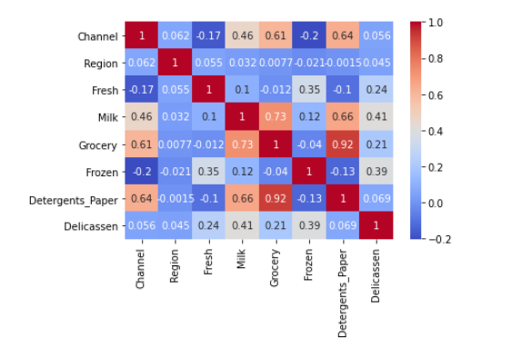
Discoveries from EDA – Correlation Matrix
Varying levels of correlation between variables e.g.,
High positive correlation between Milk & Grocery.
Negative correlation between Frozen & Grocery

Slide 9
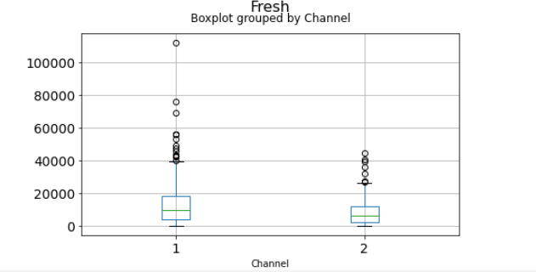
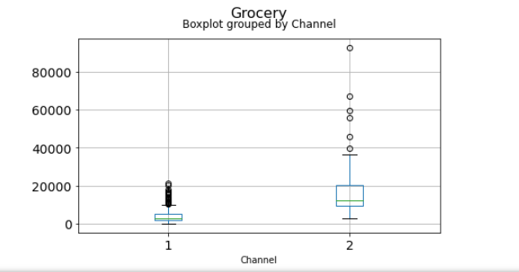
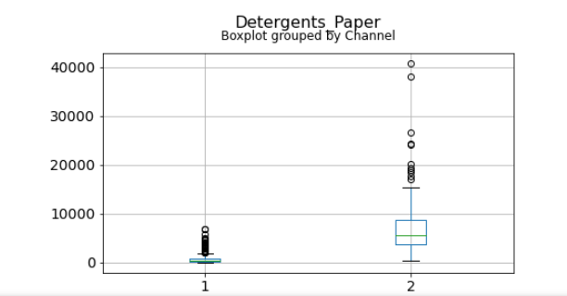
Discoveries from EDA – Box plots grouped by Channel
Presence of outliers in the upper quartile

Slide 10
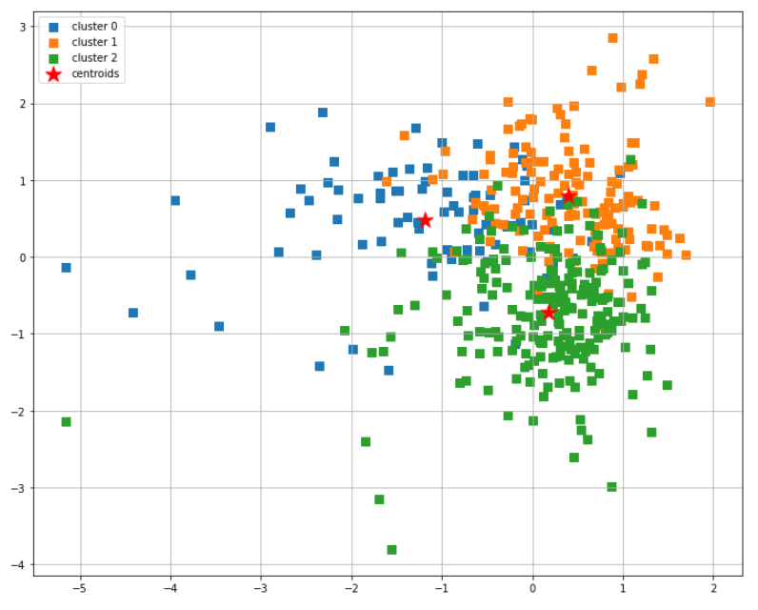
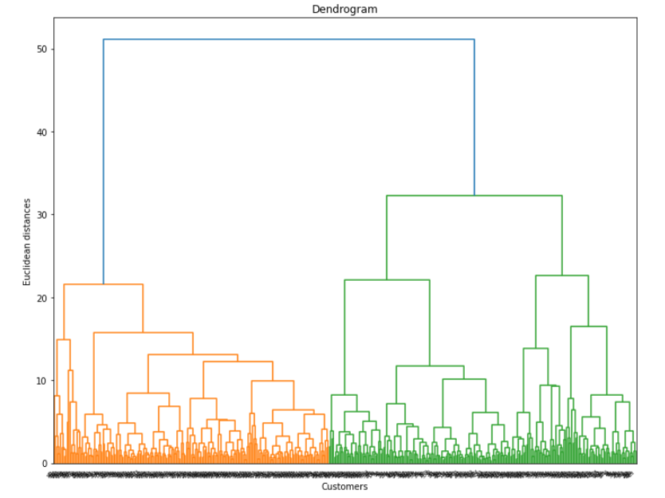
Result of Clustering – K-Means & Hierarchical
Fresh
Milk
Hierarchical
K-Means

Slide 11
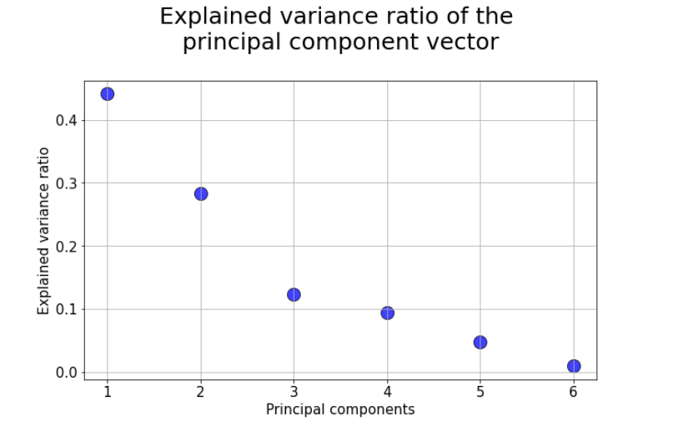
Dimensionality Reduction with PCA

Slide 12
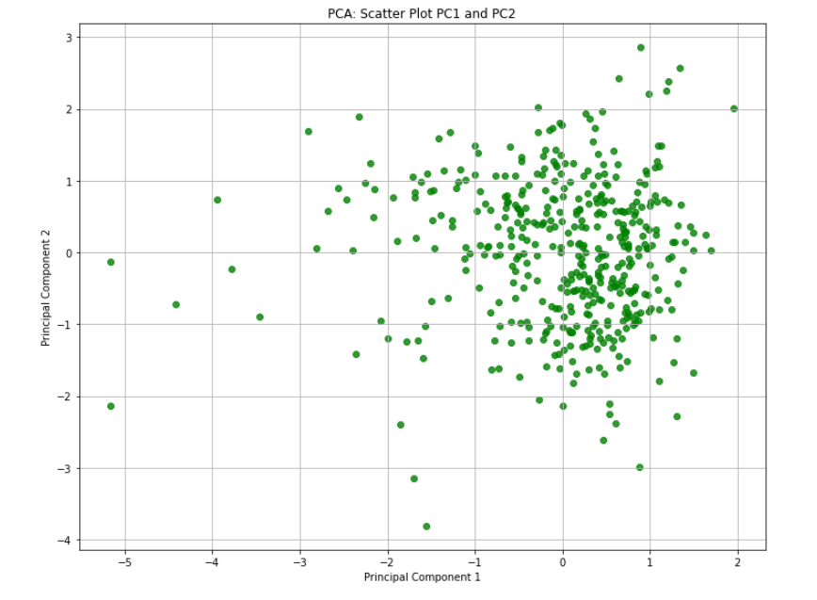
Final Plot After Reducing Features using PCA

Slide 13
Conclusion
The dataset is asymmetrical and right skewed. Correlations amongst the features varies. There are strong positive as well as negative correlations.
Most sales are from Region 3. Purchases from channel 1 is ~double of channel 2.
The clustering in this dataset is not distinct. There are areas of ovelaps and the inter-cluster distance is low.
All the six numerical features can be reduced to 2 or 3 components that will be representative of the features

Slide 14

https://github.com/AbiAfolabi/ml-project-unsupervised-learning

